Slide 1

Profit-Aware and Explainable Customer Churn Prediction Using Cost-Sensitive Learning
Predicting Customer Attrition with Intelligence and Insight
by: Aadya Vaid and Devica Vasan

Slide 2
Project Overview & Dataset Details
Problem & Objective
Customer churn impacts long-term profitability; churn datasets are highly imbalanced.
Goal: Build a profit-aware, interpretable churn prediction model that identifies high-value churners.
Dataset - Credit Card User Behaviour Dataset
Overview
The dataset includes 10,128 customer records with 23 demographic, financial, and behavioral attributes in a clean CSV format without missing values. It has an imbalanced class distribution of 84% active and 16% churned customers, reflecting real banking scenarios and making it suitable for churn prediction.
Key Feature Categories
The dataset features demographic details such as age, gender, education, income, and marital status, along with account information like credit limit, revolving balance, and utilization ratio. It also includes behavioral data such as transaction amount and count, months inactive, contact frequency, relationship duration, and product count—key indicators of churn behavior.
Why This Dataset?
This dataset is ideal because it captures real customer behavior and has a natural class imbalance that supports cost-sensitive and CLV-weighted modeling. Its high-quality, diverse features make it a strong foundation for building an accurate and profit-focused churn prediction model.

Slide 3
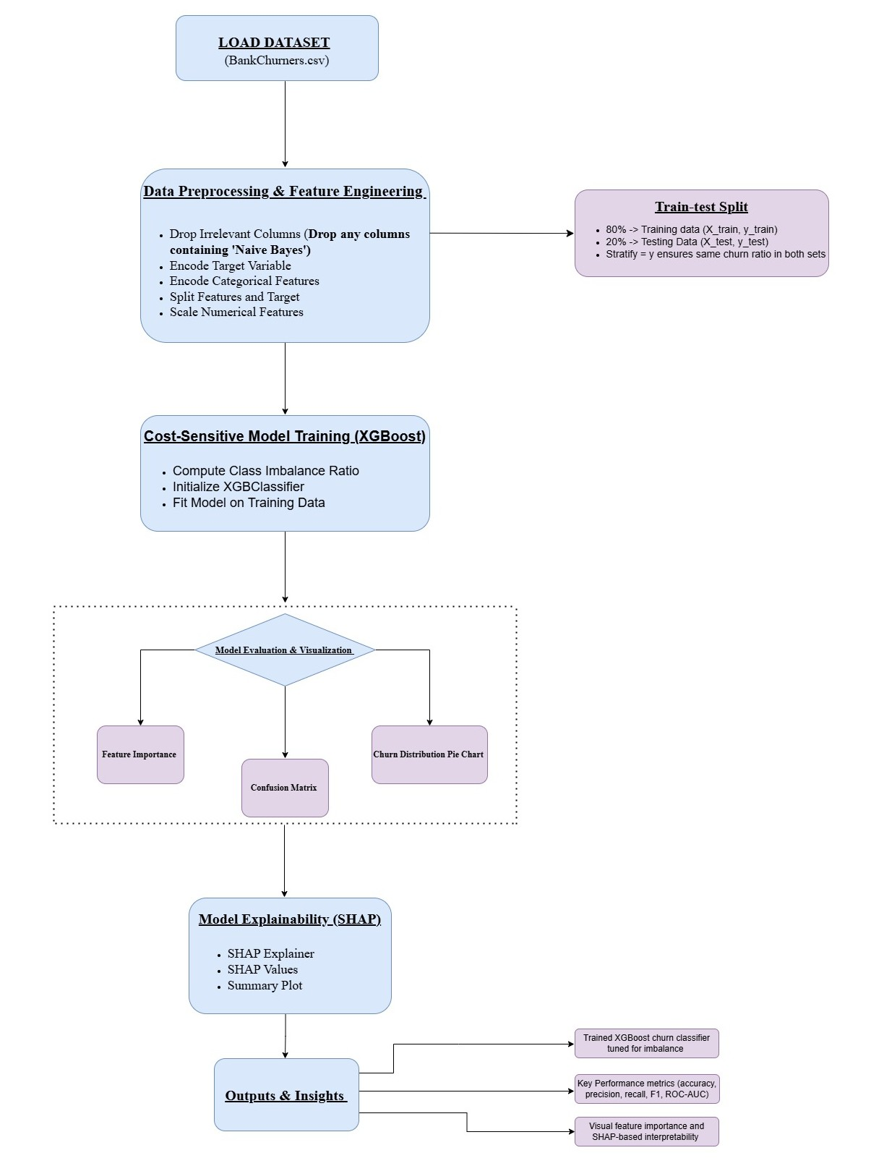
Methodology and Model Architecture
Data preprocessing: remove irrelevant features, encode categoricals, standardize numerical values.
Apply 80:20 stratified split to preserve churn distribution.
Train cost-sensitive XGBoost with scale_pos_weight + CLV-based sample weights.
Use tuned hyperparameters for optimized performance.
Evaluate using Accuracy, Precision, Recall, F1-Score, ROC-AUC.
Apply SHAP explainability to understand feature impact and key churn drivers.
This methodology creates a churn prediction system that is both accurate and profit-aware, focusing on customers that matter most to the business. By combining cost-sensitive learning with transparent SHAP insights, the model supports more informed, targeted, and effective customer retention strategies.

